Slide 1
Name : Vishwam Tiwari
College : Gyan Ganga Institute of Technology & Sciences Jabalpur (M.P.)
Branch : Electronics & Communication Engineering
Year : Btech. 3rd Year (5th Sem)
Email Address : tiwarivishwam82@gmail.com
Internship Title : Smart Agriculture system based on
IoT - SB52473
Project ID : SPS_PRO_101

Slide 2
Smart Agriculture system based on IoT

Slide 3
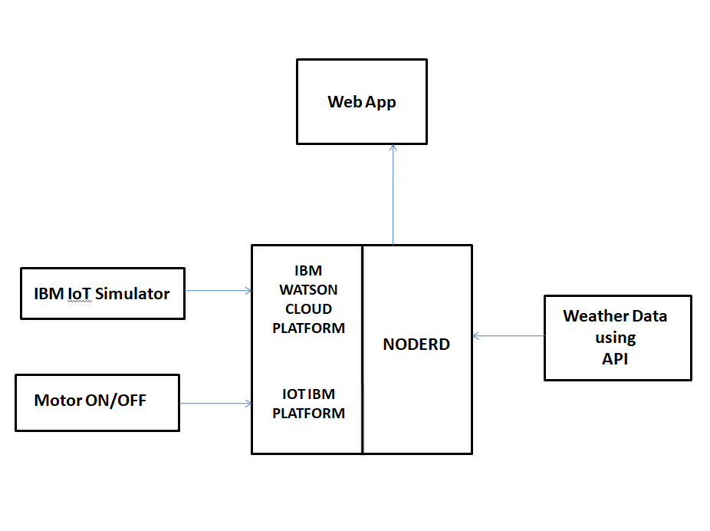
Block diagram of the Smart Agriculture System using IoT

Slide 4
Future Scope
Future work would be focused more on increasing sensors on this system to fetch more data especially with regard to Pest Control and by also integrating GPS module in this system to enhance this Agriculture IoT Technology to full-fledged Agriculture Precision ready product.
IoT sensors capable of providing farmers with information about crop yields, rainfall, pest infestation, and soil nutrition are invaluable to production and offer precise data which can be used to improve farming techniques over time.

